Slide 1



ISE 503: DATA MANAGEMENT PROJECT
Fitness Center Database Management System
Prof. Praveen Tripathi

Slide 2



Team and their Responsibilities
Name | SBU ID | Responsibilities
Swati Swati | 116778659 | SQL queries (4) SQL Schema Creation Data Population Streamlit GUI Team Coordination
Shaunak Rahul mahajan | 116553078 | SQL queries(3) Visualisation Backend Connectivity Presentation Slides Data Population
Kabir Manoj Ohekar | 116793038 | SQL queries(3) Visualisation DB Creation Data Population Presentation Slides
Interface Key Features:
Real-time dashboard
CRUD operations for all entities
Advanced SQL queries for business insights
User-friendly GUI for non-technical users

Slide 3
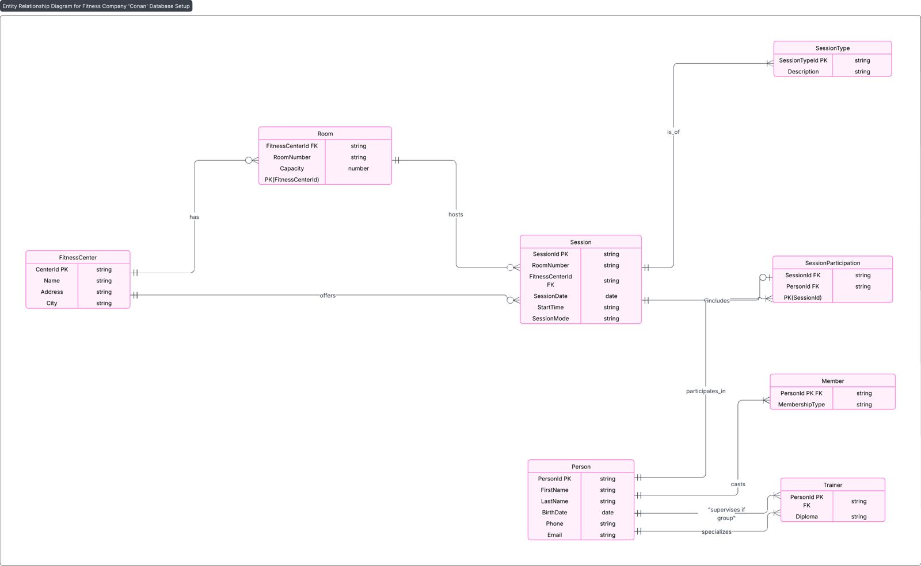
Extended Entity Relationship Diagram

Slide 4
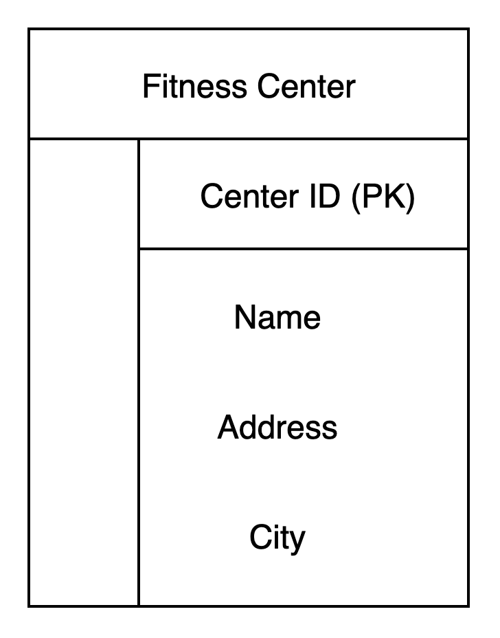
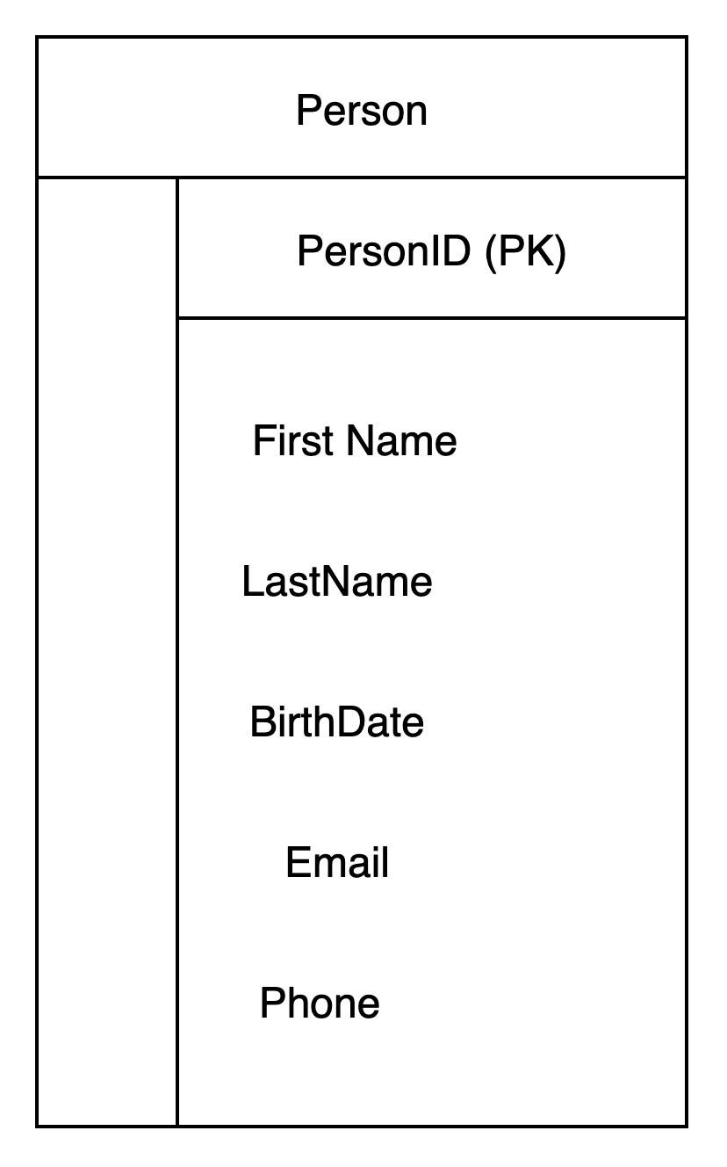
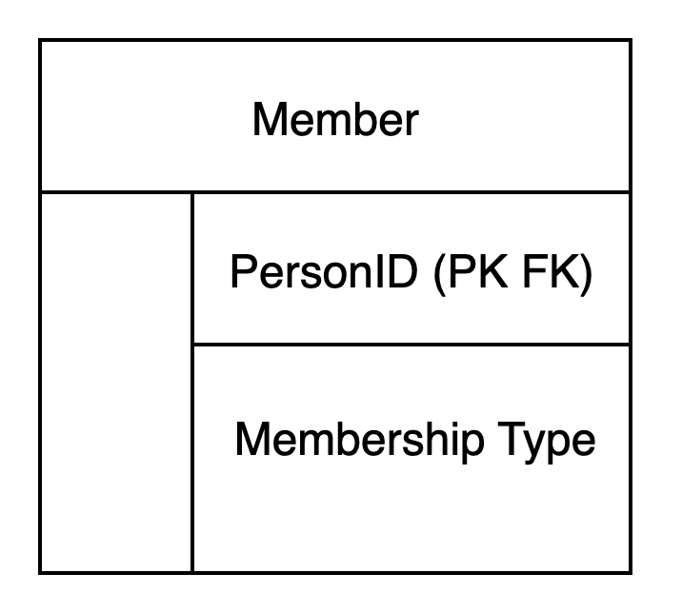
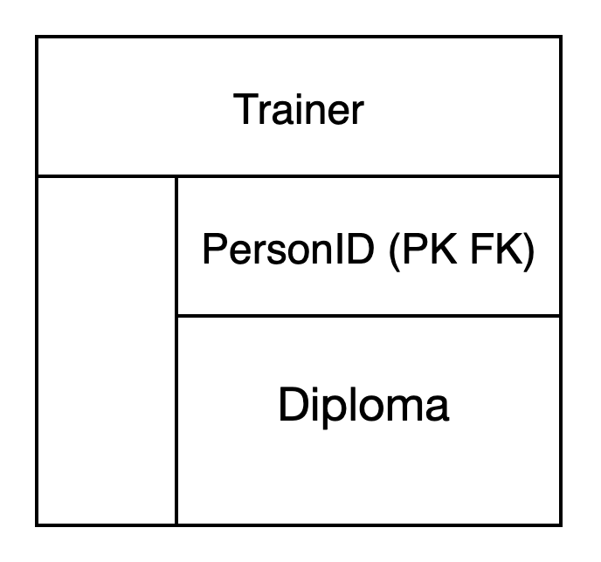
Entities and Attributes

Slide 5
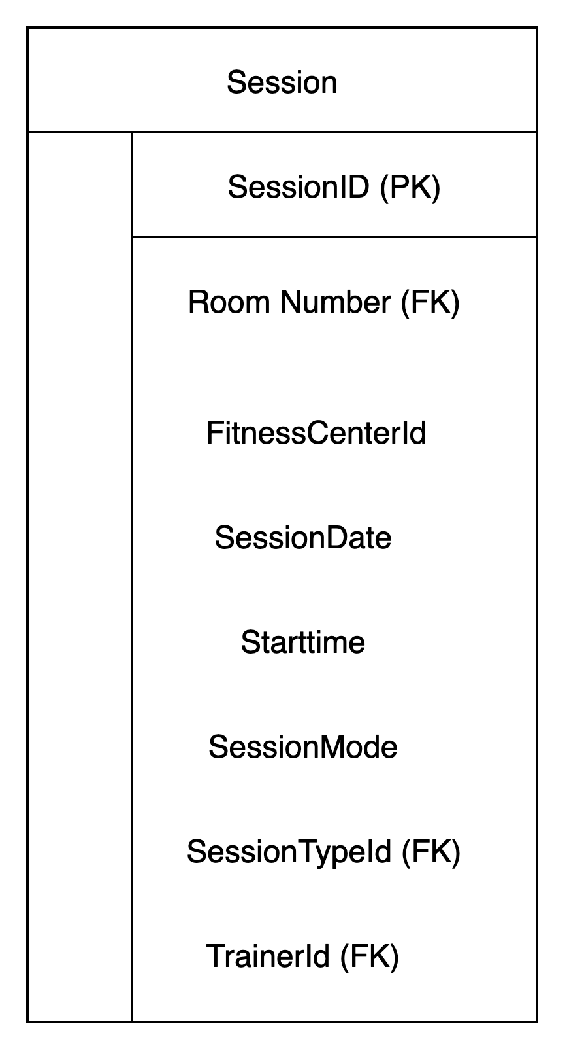
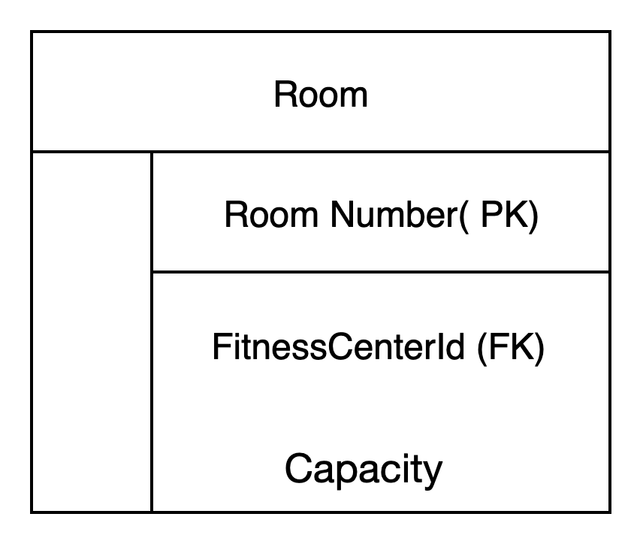
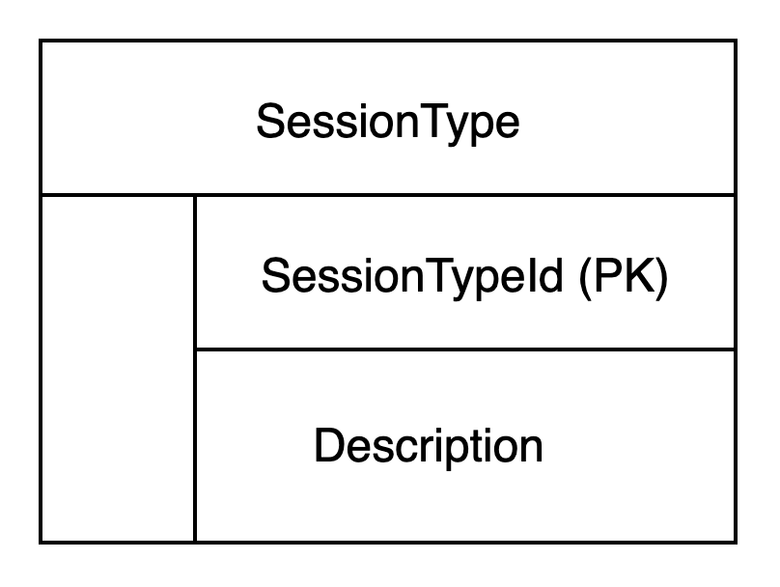
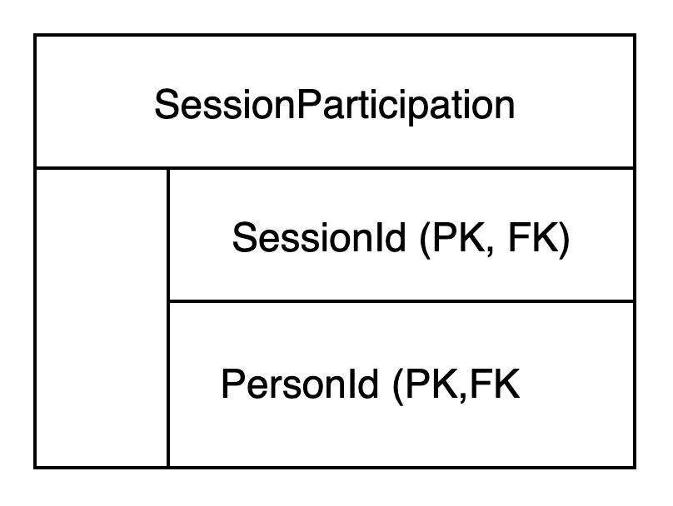
Entities and Attributes

Slide 6
Constraints and Relationships
Table | Primary Key(s) | Foreign Key(s) & References | Not Null Fields
FitnessCenter | CenterId | — | Name, Address, City
Room | FitnessCenterId, RoomNumber | FitnessCenterId → FitnessCenter.CenterId | Capacity
Person | PersonId | — | FirstName, LastName, BirthDate
Member | PersonId | PersonId → Person.PersonId | —
Trainer | PersonId | PersonId → Person.PersonId | —
SessionType | SessionTypeId | — | —
Session | SessionId | (FitnessCenterId, RoomNumber) → Room, SessionTypeId → SessionType, TrainerId → Trainer | SessionDate, StartTime, SessionMode
SessionParticipation | SessionId, PersonId | SessionId → Session, PersonId → Person

Slide 7
Cardinalities
Relationship | Cardinality | Description
FitnessCenter — Room | 1 : N | One fitness center has many rooms
Person — Member | 1 : 0..1 | A person can be a member (not all persons are members)
Person — Trainer | 1 : 0..1 | A person can be a trainer (not all persons are trainers)
Room — Session | 1 : N | One room can host many sessions
SessionType — Session | 1 : N | One session type can be used in many sessions
Trainer — Session | 1 : N | One trainer can supervise many sessions
Session — SessionParticipation | 1 : N | One session can have many participations (attendees)
Person — SessionParticipation | 1 : N | One person can participate in many sessions
Member — SessionParticipation | 1 : N | (Only members participate in sessions)
SessionParticipation (M:N bridge) | M : N | Many members attend many sessions (via SessionParticipation)

Slide 8
Interesting Questions Answered
Which members participated in the most sessions this month?
Identify members with the most session participations in the current or a specific month.
Current Month
SELECT m.PersonId, p.FirstName, p.LastName, COUNT(sp.SessionId) AS SessionsThisMonth
FROM Member m
JOIN Person p ON m.PersonId = p.PersonId
JOIN SessionParticipation sp ON m.PersonId = sp.PersonId
JOIN Session s ON sp.SessionId = s.SessionId
WHERE MONTH(s.SessionDate) = MONTH(CURDATE()) AND YEAR(s.SessionDate) = YEAR(CURDATE())
GROUP BY m.PersonId, p.FirstName, p.LastName
ORDER BY SessionsThisMonth DESC;
Specific Month
SELECT m.PersonId, p.FirstName, p.LastName, COUNT(sp.SessionId) AS SessionsThisMonth
FROM Member m
JOIN Person p ON m.PersonId = p.PersonId
JOIN SessionParticipation sp ON m.PersonId = sp.PersonId
JOIN Session s ON sp.SessionId = s.SessionId
WHERE MONTH(s.SessionDate) = 7 AND YEAR(s.SessionDate) = 2024
GROUP BY m.PersonId, p.FirstName, p.LastName
ORDER BY SessionsThisMonth DESC;

Slide 9
Interesting Questions Answered Contd.
2. Which trainers have supervised the most group sessions of a specific type (e.g., Aerobics)?
Find trainers who conducted the most group sessions for a given session type (e.g., Aerobics).
SELECT t.PersonId, p.FirstName, p.LastName, st.Description AS SessionType, COUNT(s.SessionId) AS GroupSessions
FROM Trainer t
JOIN Person p ON t.PersonId = p.PersonId
JOIN Session s ON t.PersonId = s.TrainerId
JOIN SessionType st ON s.SessionTypeId = st.SessionTypeId
WHERE s.SessionMode = 'group' AND st.Description = 'Aerobics'
GROUP BY t.PersonId, p.FirstName, p.LastName, st.Description
ORDER BY GroupSessions DESC;
3. What is the average number of participants per group session by session type?
Calculate average number of participants in group sessions, grouped by session type.
SELECT st.Description AS SessionType, ROUND(AVG(sub.Participants)) AS AvgParticipants
FROM SessionType st
JOIN (
SELECT s.SessionTypeId, s.SessionId, COUNT(sp.PersonId) AS Participants
FROM Session s
LEFT JOIN SessionParticipation sp ON s.SessionId = sp.SessionId
WHERE s.SessionMode = 'group'
GROUP BY s.SessionTypeId, s.SessionId
) sub ON st.SessionTypeId = sub.SessionTypeId
GROUP BY st.Description;

Slide 10
Interesting Questions Answered Contd.
4. Which rooms in a fitness center are underutilized (Host fewer than 2 sessions per week)?
List rooms that hosted fewer than a threshold number of sessions in a week (less than 2).
Current Date
SELECT r.FitnessCenterId, r.RoomNumber, fc.Name AS FitnessCenter, COUNT(s.SessionId) AS SessionsPerWeek
FROM Room r
JOIN FitnessCenter fc ON r.FitnessCenterId = fc.CenterId
LEFT JOIN Session s ON r.FitnessCenterId = s.FitnessCenterId AND r.RoomNumber = s.RoomNumber
AND YEARWEEK(s.SessionDate, 1) = YEARWEEK(CURDATE(), 1)
GROUP BY r.FitnessCenterId, r.RoomNumber, fc.Name
HAVING SessionsPerWeek <= 2;
Specific Date (e.g., Week of July 1, 2024)
SELECT r.FitnessCenterId, r.RoomNumber, fc.Name AS FitnessCenter, COUNT(s.SessionId) AS SessionsPerWeek
FROM Room r
JOIN FitnessCenter fc ON r.FitnessCenterId = fc.CenterId
LEFT JOIN Session s ON r.FitnessCenterId = s.FitnessCenterId AND r.RoomNumber = s.RoomNumber
AND YEARWEEK(s.SessionDate, 1) = YEARWEEK('2024-07-01', 1)
GROUP BY r.FitnessCenterId, r.RoomNumber, fc.Name
HAVING SessionsPerWeek < 2;

Slide 11
Interesting Questions Answered Contd.
5. List members who have never participated in any session yet
Show members who haven't participated in any sessions.
SELECT m.PersonId, p.FirstName, p.LastName, p.Email, p.Phone, m.MembershipType
FROM Member m
JOIN Person p ON m.PersonId = p.PersonId
LEFT JOIN SessionParticipation sp ON m.PersonId = sp.PersonId
WHERE sp.SessionId IS NULL;

Slide 12
Interesting Questions Answered Contd.
6. Which fitness center has hosted the highest number of sessions in Q3 2024 or last quarter?
Find the fitness center that hosted the most sessions in the last or specific quarter.
Last Quarter (Relative to Current Date)
SELECT fc.CenterId, fc.Name, COUNT(s.SessionId) AS NumSessions
FROM FitnessCenter fc
JOIN Room r ON fc.CenterId = r.FitnessCenterId
JOIN Session s ON r.FitnessCenterId = s.FitnessCenterId AND r.RoomNumber = s.RoomNumber
WHERE QUARTER(s.SessionDate) = QUARTER(DATE_SUB(CURDATE(), INTERVAL 1 QUARTER))
AND YEAR(s.SessionDate) = YEAR(DATE_SUB(CURDATE(), INTERVAL 1 QUARTER))
GROUP BY fc.CenterId, fc.Name
ORDER BY NumSessions DESC
LIMIT 1;
Specific Quarter (Q3 2024)
SELECT fc.CenterId, fc.Name, COUNT(s.SessionId) AS NumSessions
FROM FitnessCenter fc
JOIN Room r ON fc.CenterId = r.FitnessCenterId
JOIN Session s ON r.FitnessCenterId = s.FitnessCenterId AND r.RoomNumber = s.RoomNumber
WHERE QUARTER(s.SessionDate) = 3 AND YEAR(s.SessionDate) = 2024
GROUP BY fc.CenterId, fc.Name
ORDER BY NumSessions DESC
LIMIT 1;

Slide 13
Interesting Questions Answered Contd.
7. Show contact info of Premium members who attended 3 to 5 group sessions.
List Premium members with moderate (3–5) group session attendance.
SELECT m.PersonId, p.FirstName, p.LastName, p.Email, p.Phone, m.MembershipType, COUNT(sp.SessionId) AS GroupSessionsAttended
FROM Member m
JOIN Person p ON m.PersonId = p.PersonId
JOIN SessionParticipation sp ON m.PersonId = sp.PersonId
JOIN Session s ON sp.SessionId = s.SessionId
WHERE m.MembershipType = 'Premium' AND s.SessionMode = 'group'
GROUP BY m.PersonId, p.FirstName, p.LastName, p.Email, p.Phone, m.MembershipType
HAVING GroupSessionsAttended >= 5;
8. Individual Sessions on Specific Date
Fetch all individual sessions that occurred on a specified date.
SELECT s.SessionId, s.SessionDate, s.StartTime, s.FitnessCenterId, s.RoomNumber
FROM Session s
WHERE s.SessionMode = 'individual' AND s.SessionDate = '2024-07-01';

Slide 14
Interesting Questions Answered Contd.
9. Trainers Without Group Session Assignments
Identify trainers who haven't supervised any group sessions yet.
SELECT t.PersonId, p.FirstName, p.LastName, p.Email, p.Phone, t.Diploma
FROM Trainer t
JOIN Person p ON t.PersonId = p.PersonId
WHERE t.PersonId NOT IN (
SELECT TrainerId FROM Session WHERE SessionMode = 'group' AND TrainerId IS NOT NULL
);
Alternative Query with Status
SELECT t.PersonId, CONCAT(p.FirstName, ' ', p.LastName) AS TrainerName, p.Email, p.Phone, t.Diploma,
'Not Yet Assigned to Group Session' AS Status
FROM Trainer t
JOIN Person p ON t.PersonId = p.PersonId
WHERE t.PersonId NOT IN (
SELECT TrainerId FROM Session WHERE SessionMode = 'group' AND TrainerId IS NOT NULL
);

Slide 15
Interesting Questions Answered Contd.
10. Which session types are most frequently offered across all fitness centers?
Identify the kinds of sessions the chain offers the most
SELECT st.Description AS SessionType, COUNT(s.SessionId) AS NumSessions
FROM SessionType st
JOIN Session s ON st.SessionTypeId = s.SessionTypeId
GROUP BY st.Description
ORDER BY NumSessions DESC;

Slide 16
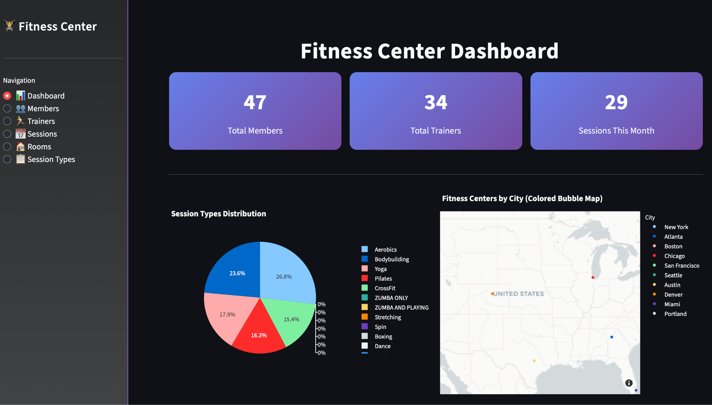
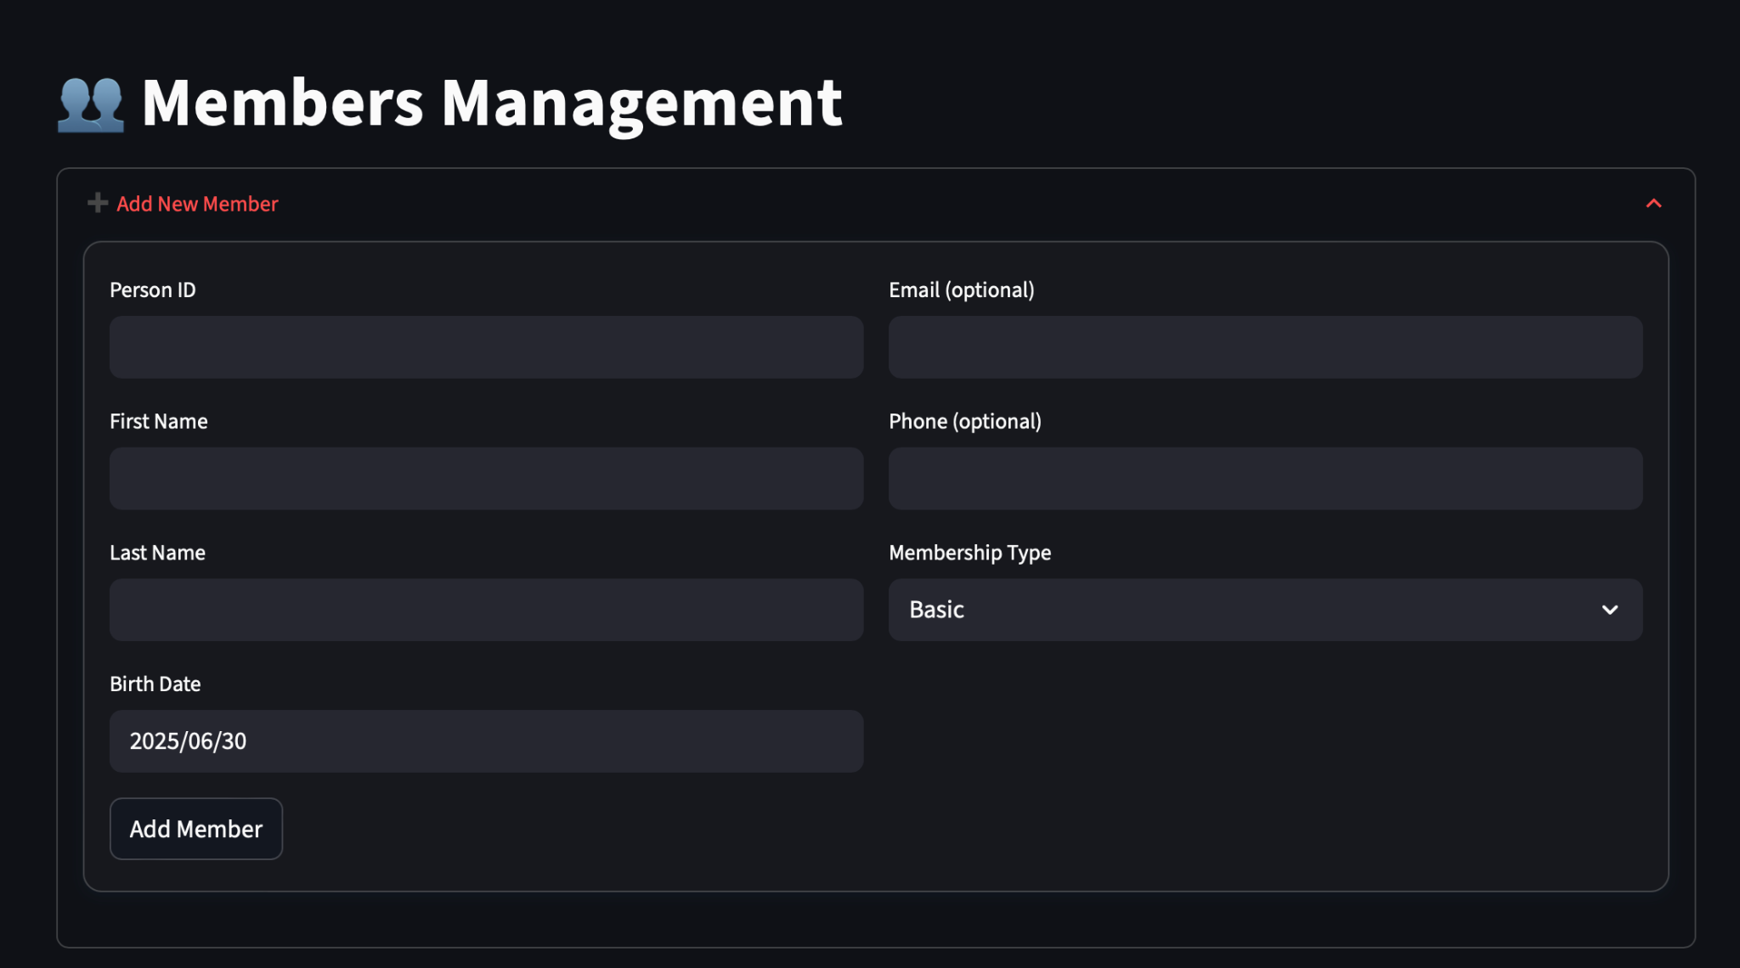
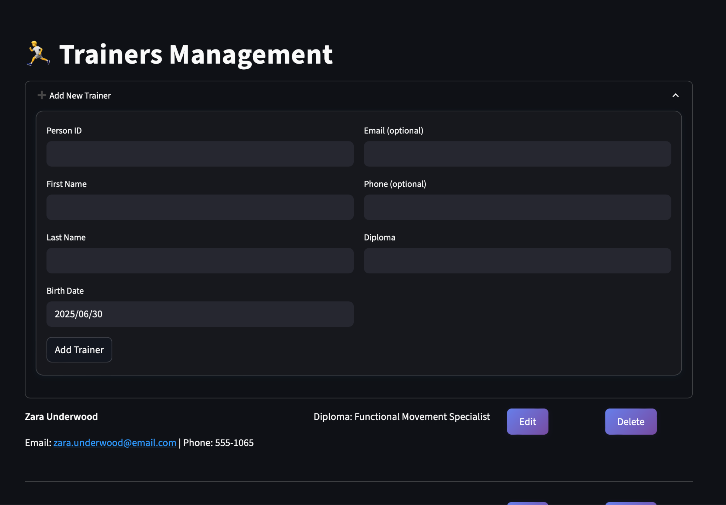
Graphical User Interface

Slide 17
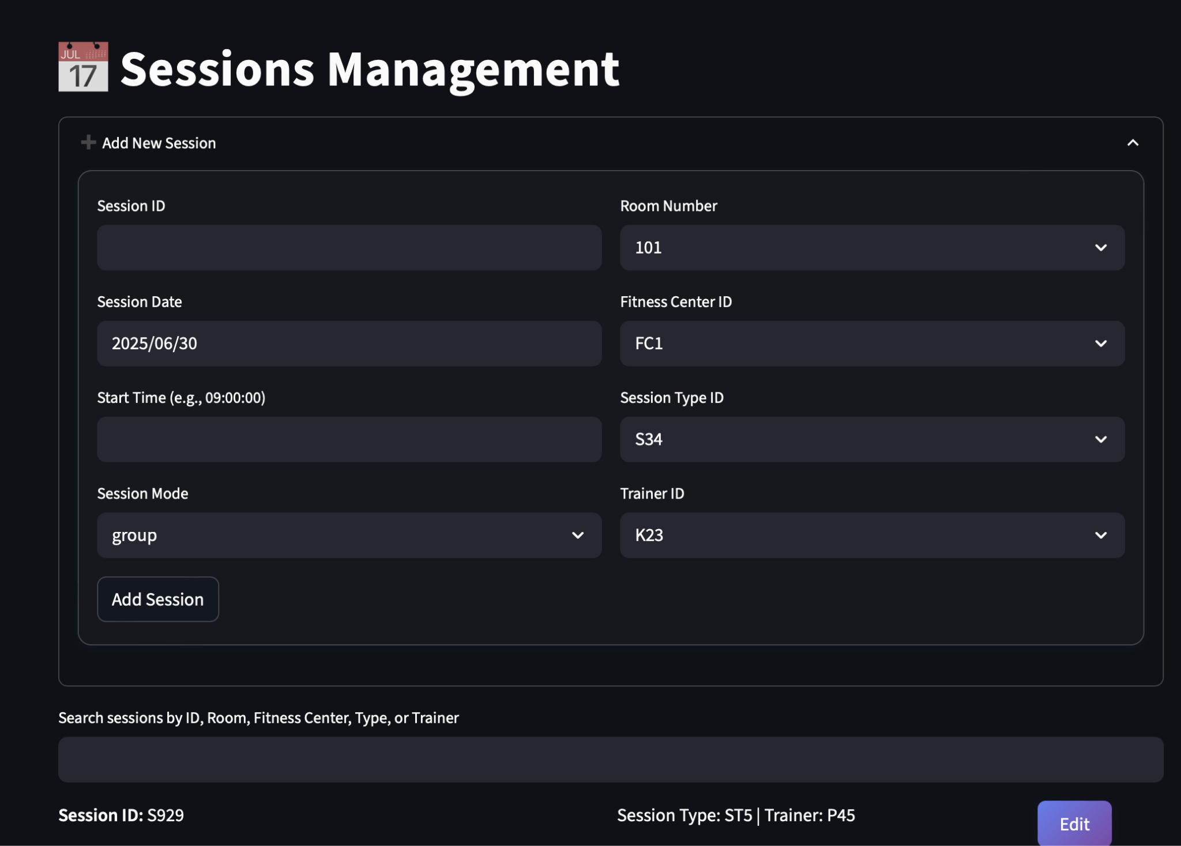
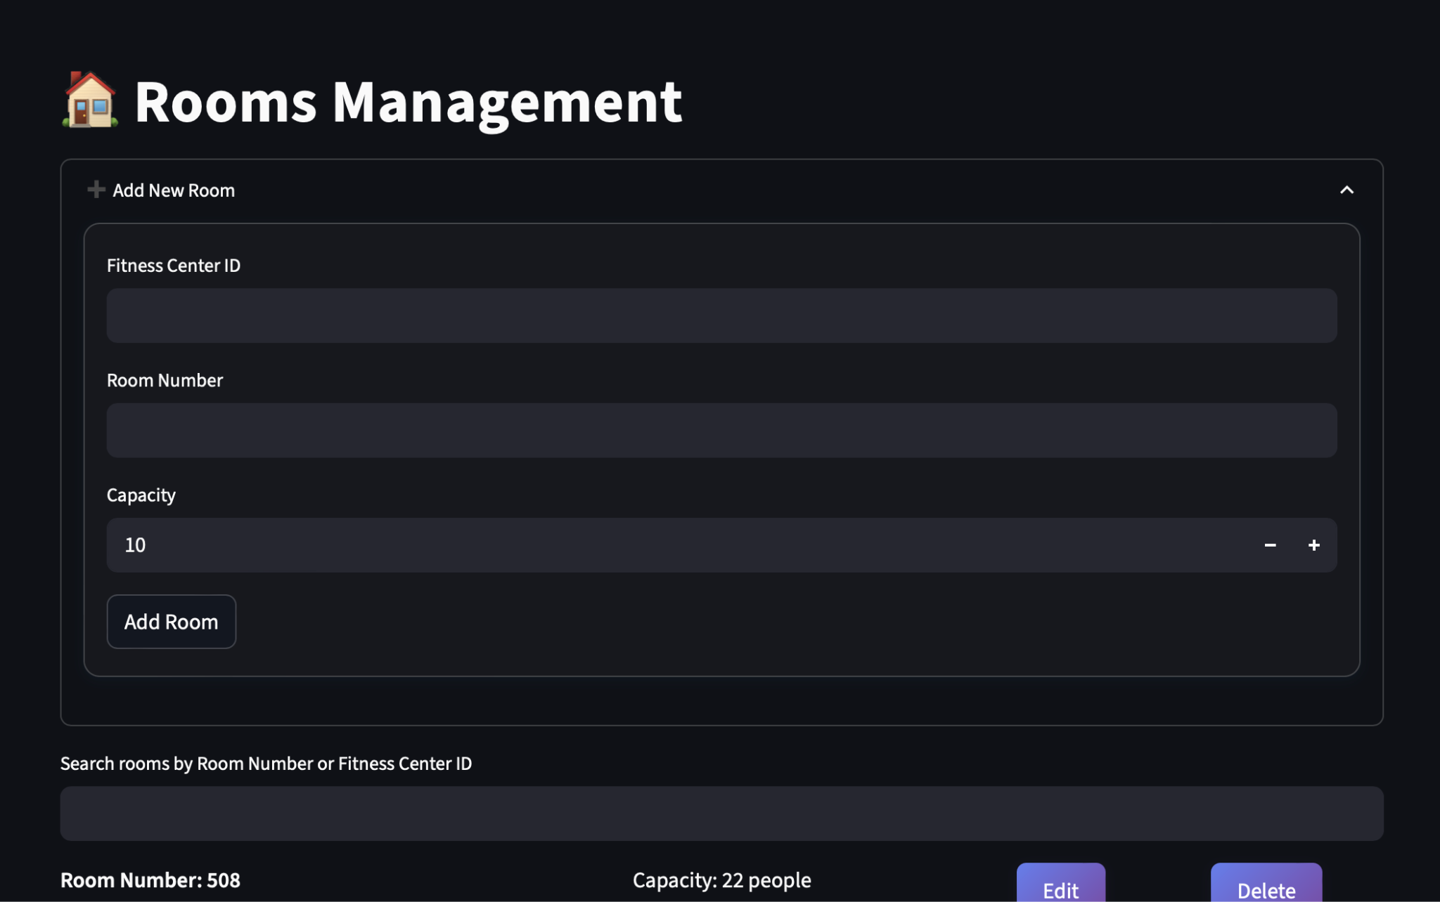
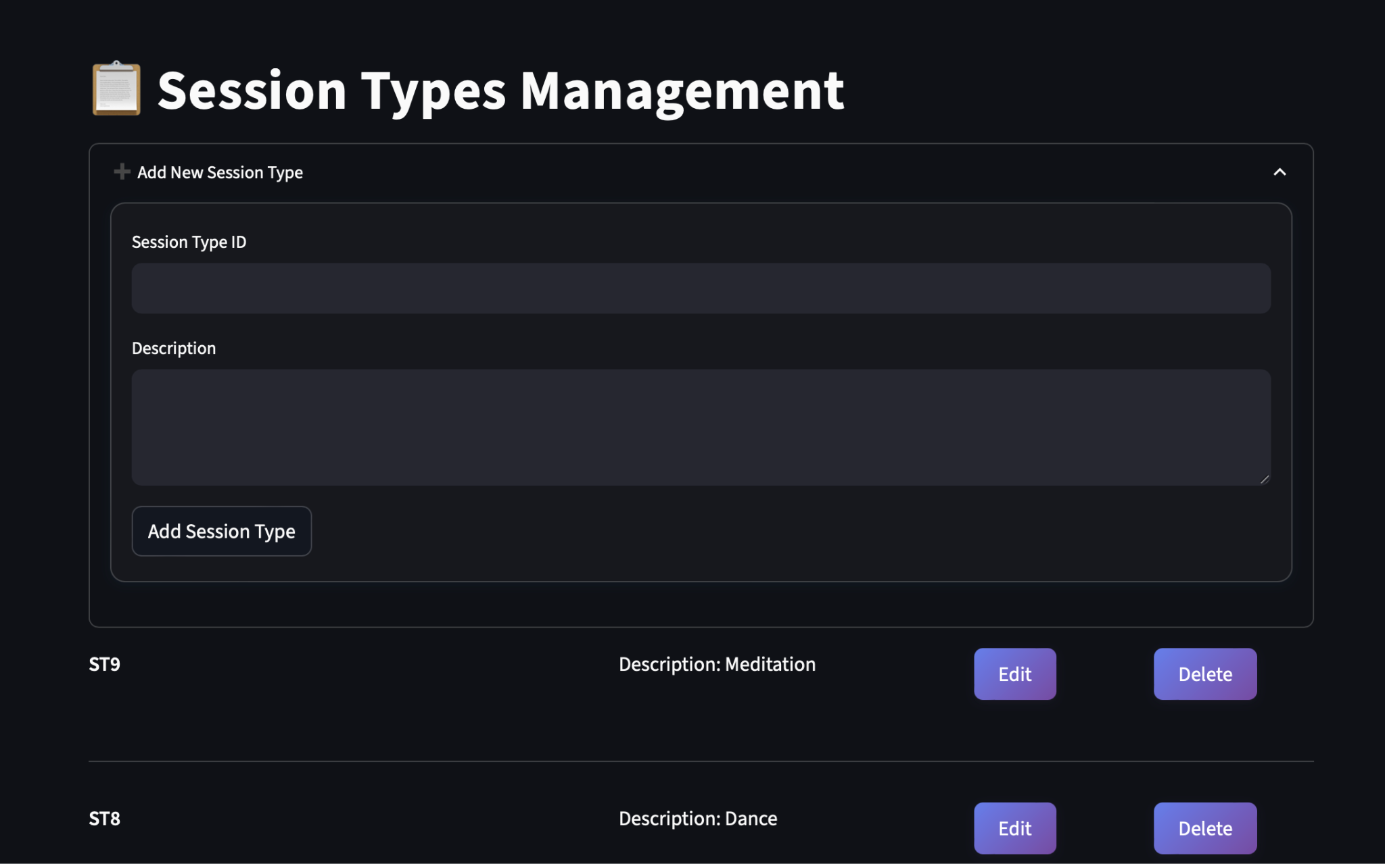
Graphical User Interface

Slide 18
ISE 503 : DATA MANAGEMENT PROJECT
THANK YOU

